Slide 1

Hacking 200
Lesson 2: Using Cloud Technology

Slide 2
Review
In the previous lessons, we learned the following:
Pentesting Process
Learn What it Does / Purpose (week 1 – Done)
Learn How it Works (week 1 + week 2 – Currently)
Analyze Design – based on research and observations (week 4)
Think of Security and Attack Paths (week 3)
Try Attack Paths (week 3)
Explore and Attack
HDFS - Hadoop Distributed File System
Fault tolerant
Designed to run on low cost hardware
Designed for high throughput, latency is accepted
YARN – Data Operating System
Cluster Resource Manager
Allows to run applications (jobs) to process data stored in HDFS
Leverages MapReduce to scale out
Enables a wide range of custom applications

Slide 3
Objectives
After this lesson, students will be able to:
Understand more how Hadoop works.
Filling in prerequisites like understanding how databases work
Connect to the lab resources.
Connect to the VPN.

Slide 4
Learn How it Works
Were going to be going into some depth on some topics (We have limited time, must be selective)
Why the depth?
If a scanner gave you a result, how do you know if it’s a false positive?
How would you know if a scanner missed something?
How would you know if there is simply “more”?
How would you find new issues in old or new technology not seen before?
Answer: Understanding the fundamental building blocks
Notes:
Without having a fundamental understanding of how things work you will start to hit a ceiling.
This ceiling is often “how do these people who are considered really good find things but I can’t”
Sure there are fundamental security concepts to pick up on but knowing about security concepts is almost never the differentiating factor, these are finite.
A lot of it comes down to how well they understand technology which enables them to be flexible and creative
Understanding a technology so well you can think of ways it can be used, and abused, beyond what was intended.
But you need to understand it

Slide 5
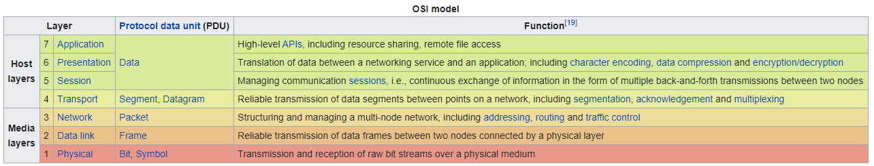
What is an application?
Again this isn’t about the specific technology, but the concepts.
Goal: Analyze the security of various technology down the road
Prerequisite: Understand concepts in Hadoop that other technology builds on
Pre-Prerequisite: How does Hadoop work?
Pre-Pre-Prerequisite: What concepts did Hadoop originate from?
Common entry level interview question for pentesting roles “What happens when you type in an address in your URL bar and visit a website?”
Notes:
“What happens when you type in an address in your URL bar and visit a website?”
Nothing should be magic, you should have some idea of what’s going on
The only “trick” to security is understanding things so well, you foresee the holes when components are stuck together
Then comes security specific experience, to be able to demonstrate or understand the impact or consequences of those holes

Slide 6
Hint
What we are talking about will be in your homework
If its unclear ask questions
If you are curious ask questions
Seriously, if you don’t understand the next couple slides in particular your homework will be hard at best.
Ask questions to the point where you could feel comfortable describing it to someone else.
For example if the word “protocol” comes up and you don’t understand, don’t glaze over it. Ask.

Slide 7
Revisit fundamentals
Layer | Description
7 – Application | Communicating with Application/program - aka “abstraction” layer – being able to send a “request”, simply shipping a package without worrying about what it takes to make that happen. Not application logic, just communication. e.g: HTTP, FTP, Telnet, DHCP, etc
6 – Presentation | Translate/transform data so the application layer understands – aka “syntax” layer e.g: ASCII, Serialization, character encoding, etc
5 – Session | How to manage a session, not just send data but have a conversation – special rules/methods for connecting e.g: pptp, SOCKS, RTP, SSH, DNS, HTTP, etc
4 – Transport | How “structured” data is transferred, variable-length data sequences e.g: TCP, UDP, etc
3 – Network | How to interact with multiple nodes - routing protocols, network-layer address assignment e.g: ipv4, ipv6, icmp, ipsec, etc
2 – Data link | Protocol/How to handle raw bits, protocol for flow control of 1 node to 1 node e.g: 802.3 Ethernet, 802.11 Wi-Fi, and 802.15.4 ZigBee
1 – Physical | Electrical Connection - raw bit streams over a physical medium e.g: Bluetooth, Ethernet, USB, etc
Notes:
Pay close attention as this will be apart of your homework
Do you actually understand what each layer means?
If I asked you to give an example could you?
For connecting to a website, what is the difference in using HTTP at Layer 5 and layer 7?
Layer 5 = is a bit closer to simple grammar, for example HTTP is a text-based protocol, so the program looks for line endings and “new lines” to know how to parse the structured data. At layer 5 there are rules of how to start to add meaning to data, simple grammar.
Layer 7 = is closer to semantics of a language, using the meaning of words. If I say hello, it means let’s start talking. In HTTP it would be the structure of the text such as “HOST” specifies where the request goes.

Slide 8
Fundamentals
“What happens when you type in an address in your web browser URL bar and visit a website?”
This is a very basic break down, each area could much much more deep in explanation
Browser sees URL
Create connection
Browser, which is just a program/application, leverages operating system capabilities to open a connection whether abstracted in libraries or using raw sockets
OS makes available resources, hardware abstracted away by libraries, APIs, firmware, etc
Attempt to connect to another node/computer/server/etc
Where are they? DNS – can ask the OS or use the “DNS server” to ask what the IP address is
Do network level routing to specific IP
Establish underlying connection to send structured consistent bytes – TCP, UDP, etc
Connection made, start an intelligent conversation
Should we use TLS/SSL? Should we talk in code?
Use the right protocols like HTTP or FTP to describe when I’m about to start talking, when I’m done talking, etc.
Start talking -> please send me your website, e.g: REST APIs
Browser receives data over connection
Browser does application logic – parses data/code, does complier logic, does presentation of data, other behavior, etc.
Notes:
Explain the flow…
We haven’t even talked about things like
how TLS/SSL works
What a browser does to display what you see
The application layer, the rules of the internet, what content you can get and what requests are blocked
How DNS works
How sockets work
Etc
We could even go into the depth of when a CPU comes into the picture
How CPUs work, there just a giant collection of switches
Did you know that the difference between a I5 and I7 is how much of those switches work and thus the speed of computation.
Its transistors/switches at the atomic level, so naturally there are some errors during production

Slide 9
Fundamentals
Were going to talk about storing data, databases, Hadoop and more
Things to keep in mind
How simple/complex was it to open a website in a browser?
…How simply/complex would it be to put data in a database?
Latch on to what facts you can
Pay close attention to the concepts
reason we analyzed the “browser to website” relationship next to the OSI model is to call out concepts.
Each part of the browser to website flow, aside from the application logic, can be stuck into the OSI model. It was built on the same concepts
Use your understanding of general concepts to fill in blanks, make educated guesses, ask the right questions, predict what could be next and determine how things “should” be
Notes:
Don’t glaze over the details in your mind, always be thinking how you get from one step to the next
While the OSI model is ultimately an example and a single part of a larger story, it’s another starting point of absorbing concepts
Use hardware and electricity to send signals
Turn those signals into data
Connect to other computers, multiple computers
Setup some rules for sending data
Give raw data actual meaning through protocols
Translate data into information application and humans can use
Do stuff with that information (this is outside the osi, but ultimately the goal)

Slide 10






Basic Web/Applications
Slightly More Advanced
Common “basic” Setup Today
Notes:
Look at setups from basic to more modern
Most basic is connecting to server over network/internet
Slightly more realistic is adding data scalability and complexity with a database
More realistic to today, is doing distribution
Start doing animations
Notice dark blue does not change, that is simple how we connect, still important though.
Light blue, the server and running process and roles start to split apart. This starts alluring to distributed architecture, dedicated resources for a role.
Orange starts to change as we start to have more of a distributed architecture for scalability
Red is where the most recent jumps are, not just load balancing its resource management and orchestration. This is the area that enables distributed processing, big data, microservice architecture, and more.

Slide 11
What is a database?
Simply an organized collection of data
IBM System R – first transaction management system that provide good transaction processing performance
first version in 1970’s by IBM based on “System R”
Made multi-table so data could be split, and record did not have to be single large "chunk".
Notes:
Even a CSV file is a primitive database, it organizes and stores data in database rows and columns in text format
However, a CSV isn’t robust enough for common needs today, a management system is needed, hence the history of databases
Conceptually its not “wrong” to think of databases as simply rows and columns like a spreadsheet and each spreadsheet are then multiple tables in a database. SQL is based of of binary trees which plays into the nature of columns and rows.

Slide 12
Traditional Databases
Online Transactional Processing (OLTP)
SQL Server, Oracle, MySQL,…
Concepts: Tables, Relationships, Transactions
Use Scenario: Operations
fast, quick updates/inserts/deletes integrity, consistency (ACID attributes)
Online Analytical Processing (OLAP)
Analysis Services, Oracle/SQL Data warehouse,..
Concepts: Cubes, Multi-Dimensional, BI,..
Use Scenarios: Reporting, BI
Data Analysis
Decision Making
Database Design
Strongly defined schema
Changes to schema comes with overhead ( e.g. the organizational process involved to change a single table or cube can take up to weeks - until all stakeholders agree)
Fast, interactive systems, especially OLTP
Notes:
(process transaction) vs (business intelligence or reporting)
OLTP - facilitate and manage transaction-oriented applications.
denotes an atomic change of state, processing in which the system responds immediately to user requests.
OLAP - approach to answer multi-dimensional analytical (MDA) queries swiftly in computing
enable users to analyze multidimensional data interactively from multiple perspectives

Slide 13
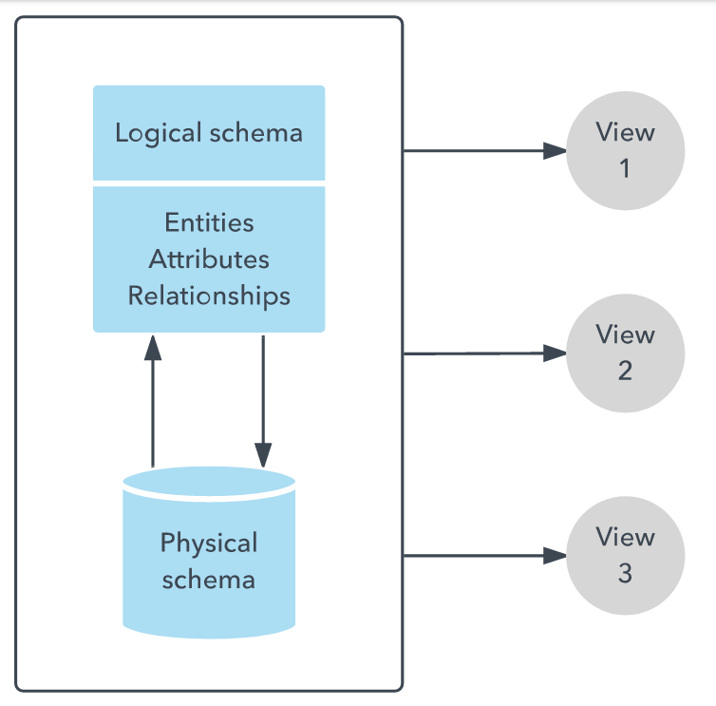
Some Key Database Concepts - Schema
Image from https://www.lucidchart.com/pages/database-diagram/database-schema
Notes:
Schema – generically organizes categories of information and the relationships among them, applies to more than just technology
Database Schema - set of rules that govern a database, or to the entire set of objects belonging to a particular user
Typically, a database designer creates a database schema to help programmers whose software will interact with the database.
A logical database schema conveys the logical constraints that apply to the stored data. It may define integrity constraints, views, and tables.
A physical database schema lays out how data is stored physically on a storage system in terms of files and indices.
https://docs.oracle.com/cd/B16276_01/doc/server.102/b14196/schema001.htm
https://www.postgresql.org/docs/8.1/ddl-schemas.html

Slide 14
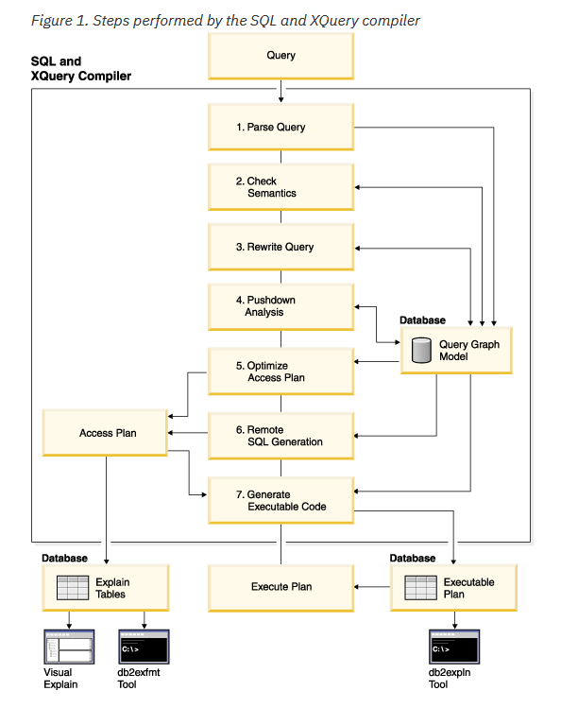
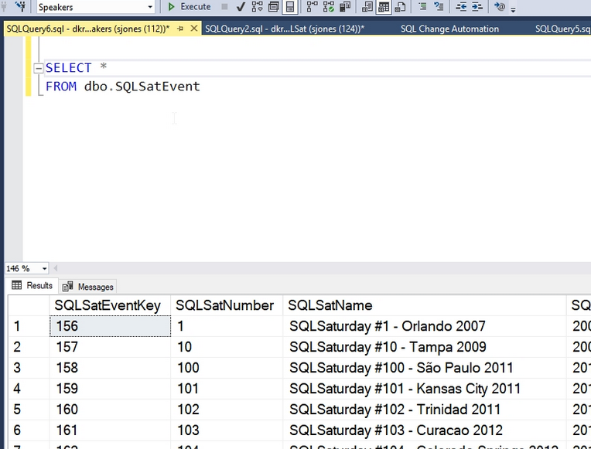
Some Key Database Concepts - Query
IBM specific
Image from https://www.sqlservercentral.com/articles/cross-database-queries-in-azure-sql-database
Image from https://www.ibm.com/support/knowledgecenter/SSEPGG_11.1.0/com.ibm.db2.luw.admin.perf.doc/doc/c0005292.html
Notes:
At a high level a database is a compiler running code (query engine) + a virtual machine for that code to run in and the software to write to disk and memory (storage engine)
(query engine) = what to do
(storage engine) = do it
query engine does:
Parse - query get parse and converted into compatible format
Check sematic - another compiling process take place which check the sematic + optimization
Execute – convert into byte code and run
Low Level details
SQL originally/primarily written in C and it uses a principle of Binary-Tree which make the incoming data to store in Rows and Columns

Slide 15
Building a Data Warehouse
User
Data Warehouse
Move Data to Processing
Extract
Transform
Load
Log Files
Other Data Sources
OLTP Systems
Oracle DB
SQL Server DB
Notes:
type of data management system that is designed to enable and support business intelligence
A data warehouse centralizes and consolidates large amounts of data from multiple sources.
analytical capabilities, derive valuable business insights
Data Lake = disparate, unfiltered data to be used later for a particular purpose
Data Warehouse = specifically intended to analyze data, data that has been readied for analysis—gathered, contextualized, and transformed

Slide 16
Big Data Processing
User
HADOOP (YARN)
Move Processing to Data
Data Lake
(Raw Data)
Log Files
Other Data…
Telemetry
Documents,…
OLTP Systems
Notes:
Many Data Streams form the Data Lake
Data is never deleted
Data Lake = disparate/distinct, unfiltered data to be used later for a particular purpose
The structure, integrity, selection, and format of the various datasets is derived at the time of analysis by the person doing the analysis
low-cost storage for unformatted
unstructured data from multiple sources
intend to use for some purpose in the future

Slide 17
Traditional DBMS and Hadoop
Traditional Database Systems
Schema on Write
Early-Binding: Pre-Defined schema in order to store the data
Expensive to change schema
Fast Reads (cost of loading is payed up front)
Most systems have a robust security model (security maturity due to existing for a while)
Hadoop
Schema on Read
Late-Binding: Schema not defined until read happens
Flexible
High latency (e.g. job submission, scheduling,..)
Better Throughput
Security design and controls was an afterthought

Slide 18
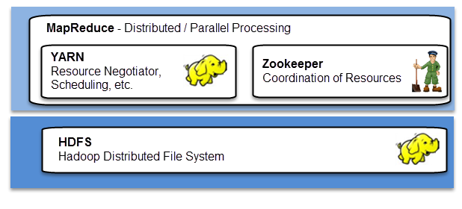
HDFS, YARN, & MapReduce
HDFS – Storage, Distributed File System
YARN – Resource Negotiation, Scheduling, etc
MapReduce – Distributed/Parallel processing and analysis of data

Slide 19
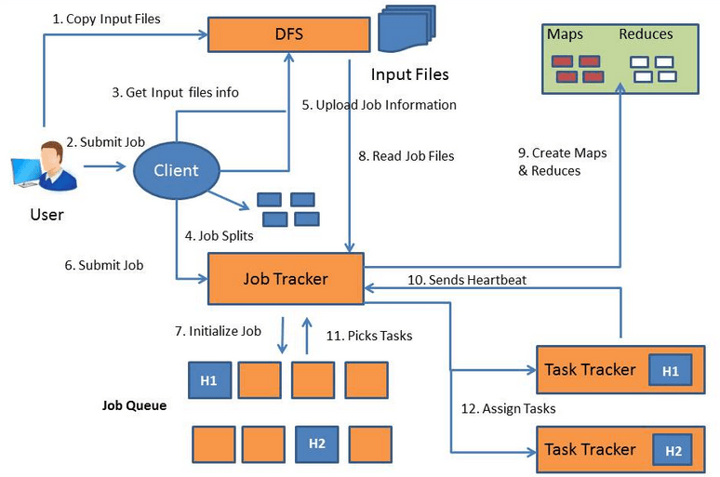
Submitting Jobs (MapReduce)
User (a person) copies the input file into the Distributed File System.
User submits the job to Client (software).
Client gets information about the input file.
Client splits the job into multiple splits.
Client upload the job information to DFS.
Client submits job to Job Tracker.
Job Tracker initializes the job in job queue.
Job Tracker reads job files from DFS to understand the job.
Job Tracker creates Map tasks and Reduce Tasks based on the job type. The number of Map tasks equal the number of input splits, which is configurable. Each Map task is running on one input split. The output of the Map task will go to Reduce Task. The number of Reduce tasks generated can be defined. The Map and Reduce tasks are running on DataNodes.
Task Trackers send Heartbeats to Job Tracker to let it know they are available for tasks.
Job Tracker picks the Task Trackers that have the most local Data.
Job Tracker assign tasks to Task Trackers.
Diagram from http://jennyxiaozhang.com/6-things-you-need-to-know-about-hadoop/

Slide 20
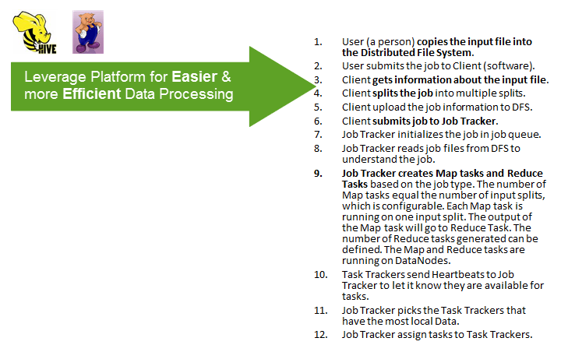
Are There Better Ways to Submit Jobs (MapReduce)?
Yes – Platforms built on YARN can help

Slide 21
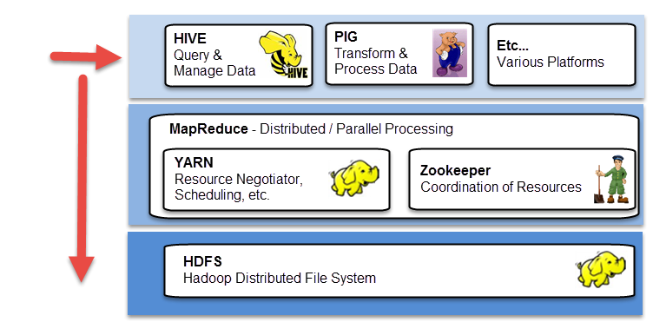
Platforms on YARN
Various platforms can help increase the effectiveness and efficiency of creating and completing a overall MapReduce job.
This is possible through specific and various methods for handling and approaching data, leveraging the existing infrastructure.

Slide 22


Pig & Hive
“Apache Pig is a platform for analyzing large data sets… lets you express data transformations such as … Users can create their own functions to do special-purpose processing.”
“The Apache Hive ™ data warehouse software facilitates querying and managing large datasets residing in distributed storage.”

Slide 23
Pig & Hive
Pig and Hive have similar goals
E.g: Make writing complex java MapReduce job simpler
Some key differences:
Pig | Hive
Great at processing/transforming data | Great at querying/managing existing data
Used in situations that need programming | Used in situations that need reporting
Operates on Client-Side of cluster | Operates on Server-Side of Cluster
Used for Semi-Structured Data | Used for Completely-Structured data

Slide 24
What is Hive?

Slide 25
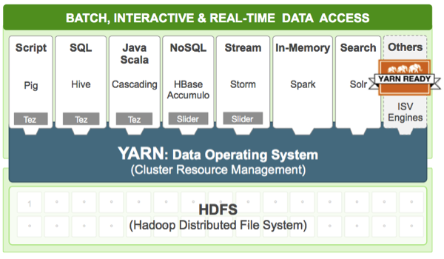
YARN – The Data Operating System
http://hortonworks.com/hadoop/yarn/

Slide 26

Apache HIVE
Data Warehouse for Hadoop
Hive QL
Provides a SQL like language for querying large amount of data
Additionally allows for Map/Reduce jobs to be plugged in
Batch processing
It is not a replacement of OLTP systems
No real time queries
Typical use case
Query over a large set of immutable data (for instance web traffic logs)

Slide 27
Apache HIVE
Map/Reduce for execution and HDFS for storage
Metastore – Derby database by default(any JDBC driver, e.g. MySQL) can be used
Extensible (support different files and User defined functions)
Can use TRANSFORM to invoke MapReduce (plugin)
Different Tables (managed vs. external)
Serialization and Deserialization (SerDe) – convert unstructured to structured data

Slide 28
HIVE – Quick Walkthrough
Hadoop and Hive commands
Creation of database
Load and Query of data
Introduction to Ambari Web UI
To reproduce the walkthrough, there are two options:
Connect to the student network and use your student VM to connect to the Sandbox system (in the internal network).
Connect to the VPN and access your host remotely through your browser.
Download and run the Sandbox VM yourself (using Oracle VirtualBox or VMWare) http://hortonworks.com/hadoop-tutorial/learning-the-ropes-of-the-hortonworks-sandbox/
The screenshots that follow are taken by hosting the Sandbox VM on my own machine

Slide 29
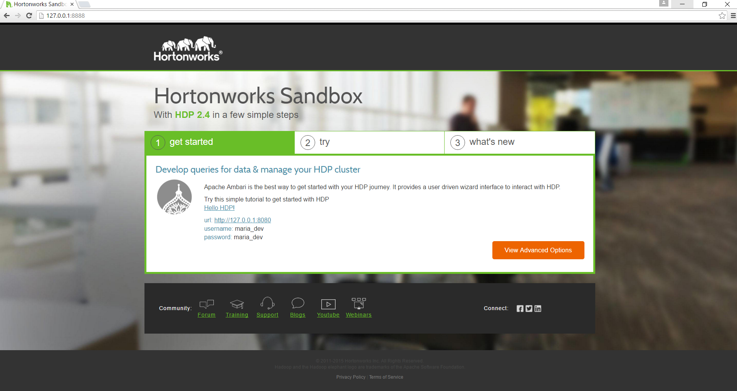
Hortonworks Sandbox Walkthrough
http://hortonworks.com/hadoop-tutorial/learning-the-ropes-of-the-hortonworks-sandbox/

Slide 30
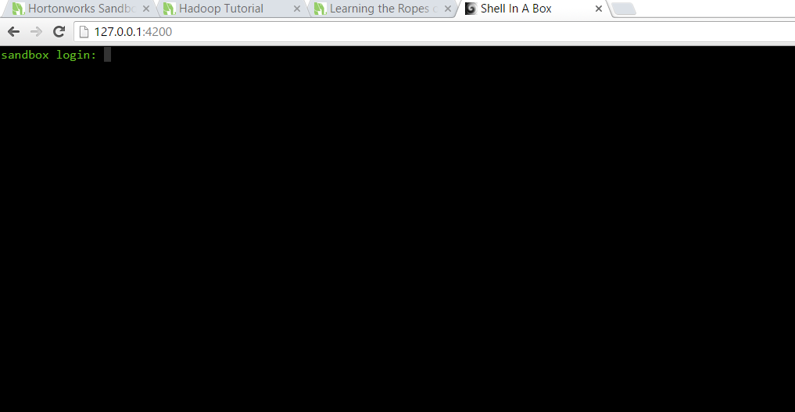
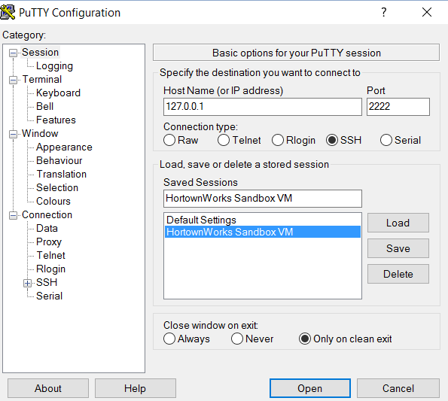
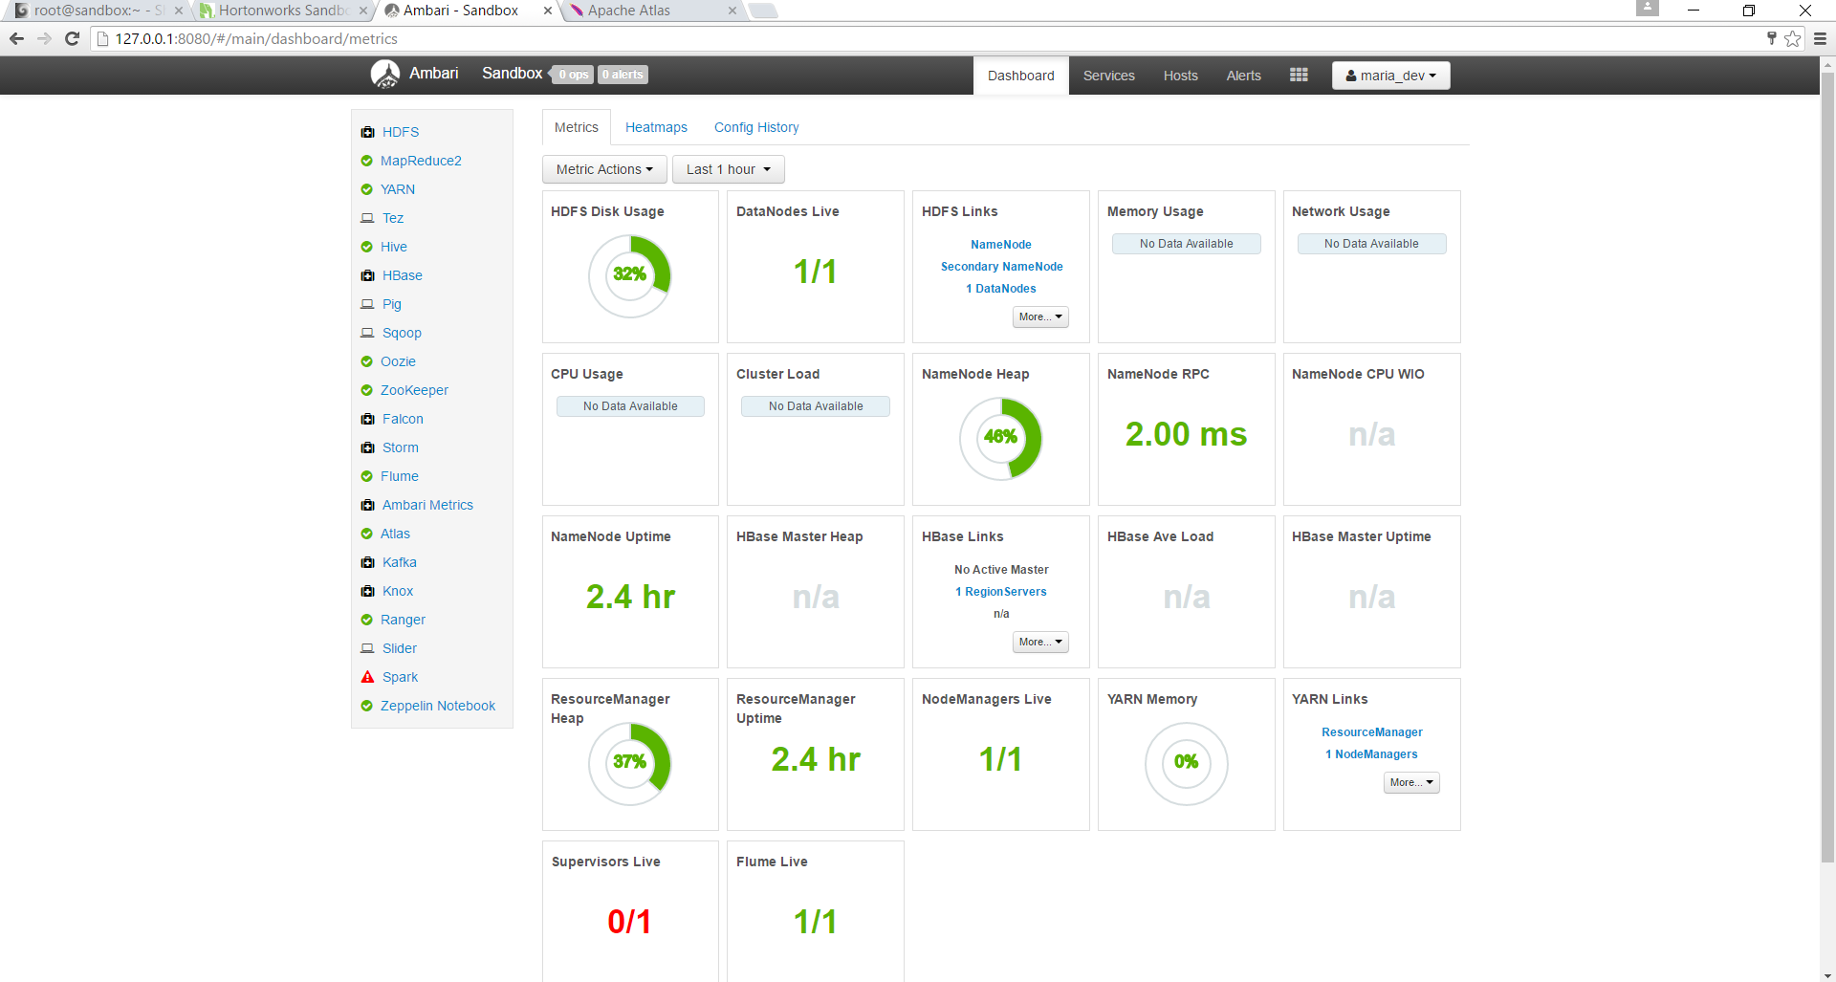
How to connect?

Slide 31
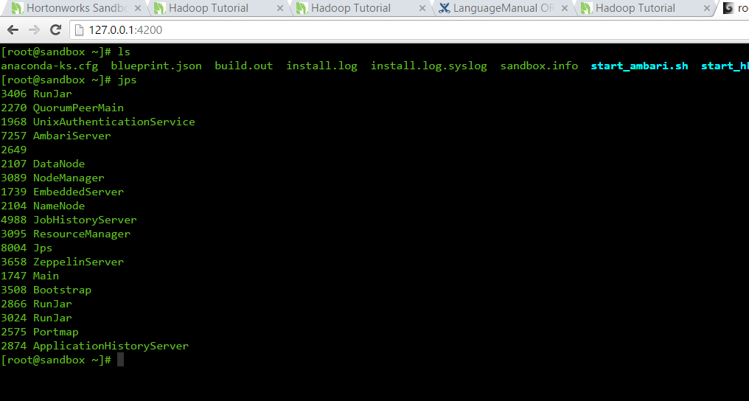
jps
Notes:
For checking running process in our Hadoop cluster we use JPS command.
JPS stands for Java Virtual Machine Process Status Tool or [JVM Process Status tool].
Below are some important points which one should remember at the time of using JPS command.
To check all running nodes on the host via jps, you need to run the command as root.
Otherwise, jps will only show nodes which you have currently logged-in user as.

Slide 32
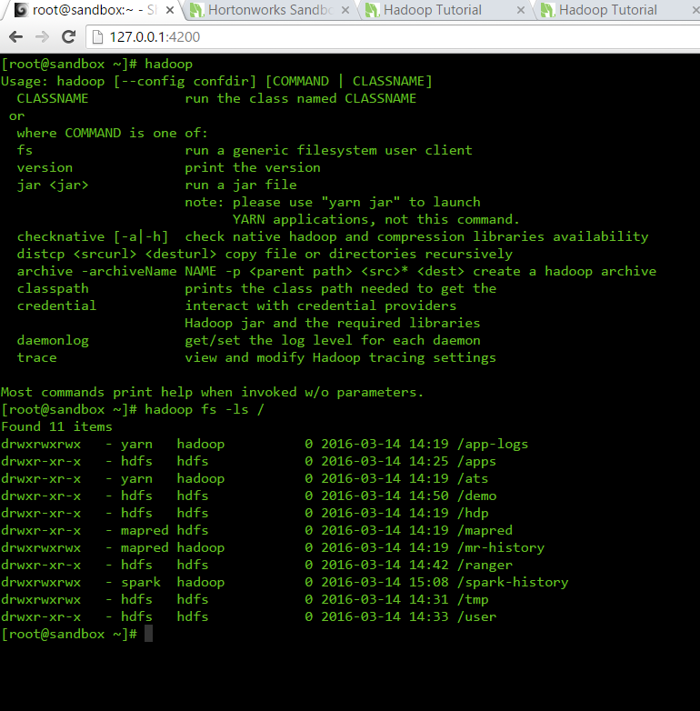
Hadoop - HDFS
Use the hadoop command
to interact with HDFS
hadoop fs –ls /
You can run any bash command
with this, e.g. to read a file
hadoop fs –cat /test.txt

Slide 33
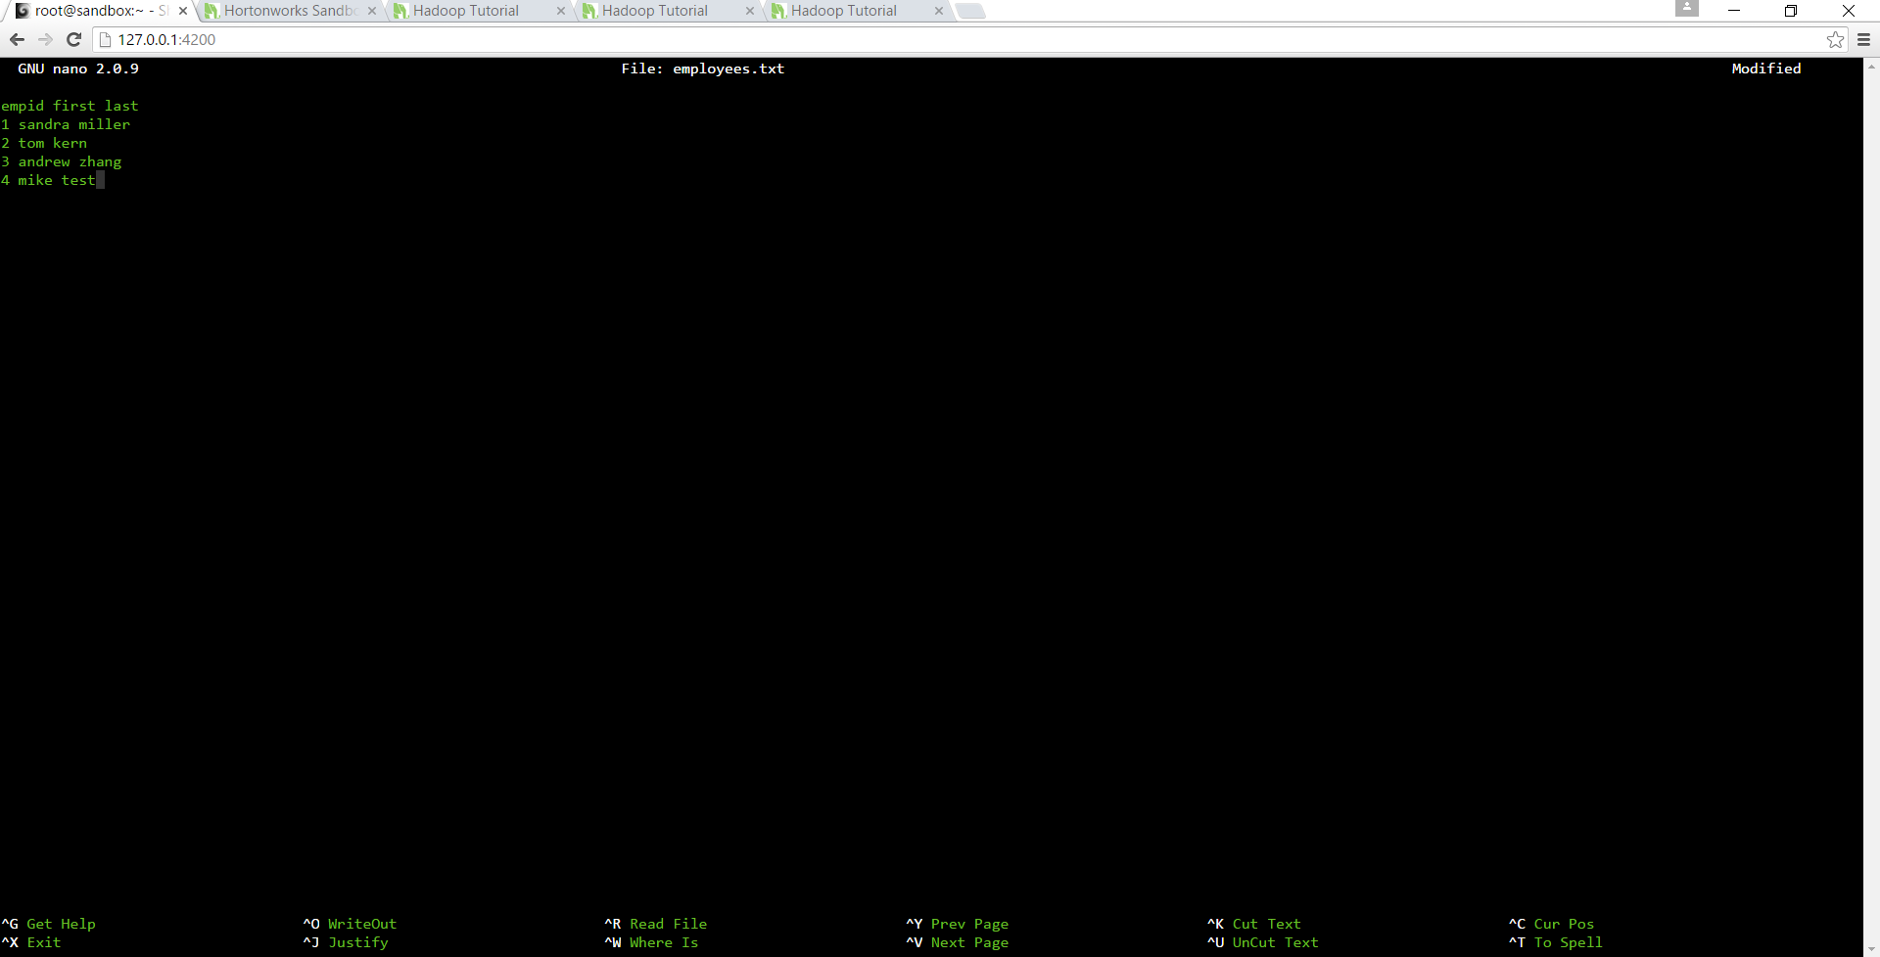
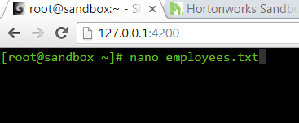
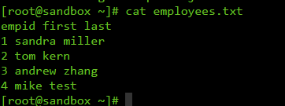
Create a file employees.txt
Install a text editor (e.g. nano, vi, gedit,…)
yum install nano
Create the file employees.txt
Exit with CTRL + X (and save changes)
Validate creation of the file

Slide 34
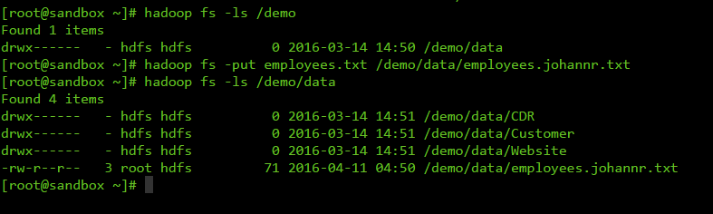
Copy the file into HDFS
hadoop fs –put employees.txt /demo/data/employees.johannr.txt

Slide 35
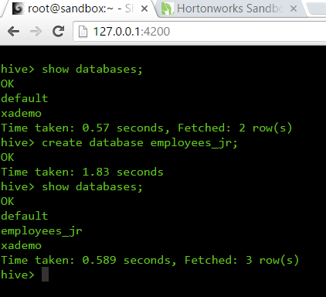
HIVE Command Line
Launch HIVE by typing
hive
Enumerate databases
show databases;
Create a new database
create database employees_name;
Use the new database
use employees_name;

Slide 36
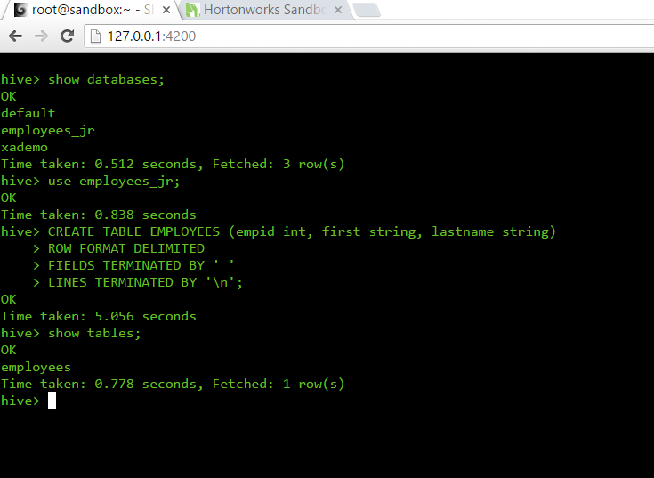
Create an Employees table
CREATE TABLE Employees (empid int, first string, last string)
ROW FORMAT DELIMITED
FIELDS TERMINATED BY ' '
LINES TERMINATED BY '\n';

Slide 37
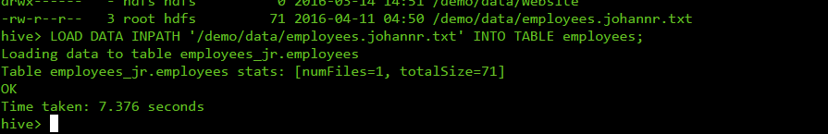
Load data from HDFS into the table
LOAD DATA INPATH '/demo/data/employees.txt' INTO TABLE employees;
HIVE distinguishes between managed and external tables. This is an example of a manage table, all the data is copied into HIVE

Slide 38
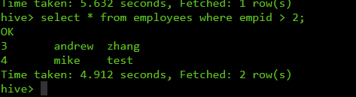
Query data
SELECT * FROM employees WHERE empid > 2;

Slide 39
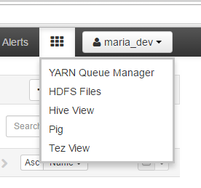
Ambari

Slide 40
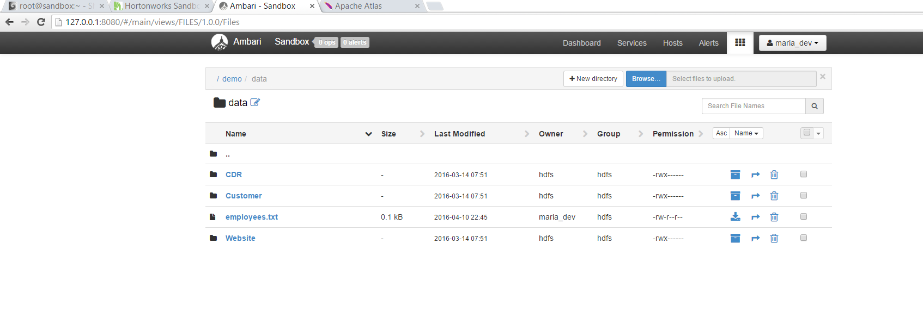
Ambari – Browsing HDFS

Slide 41
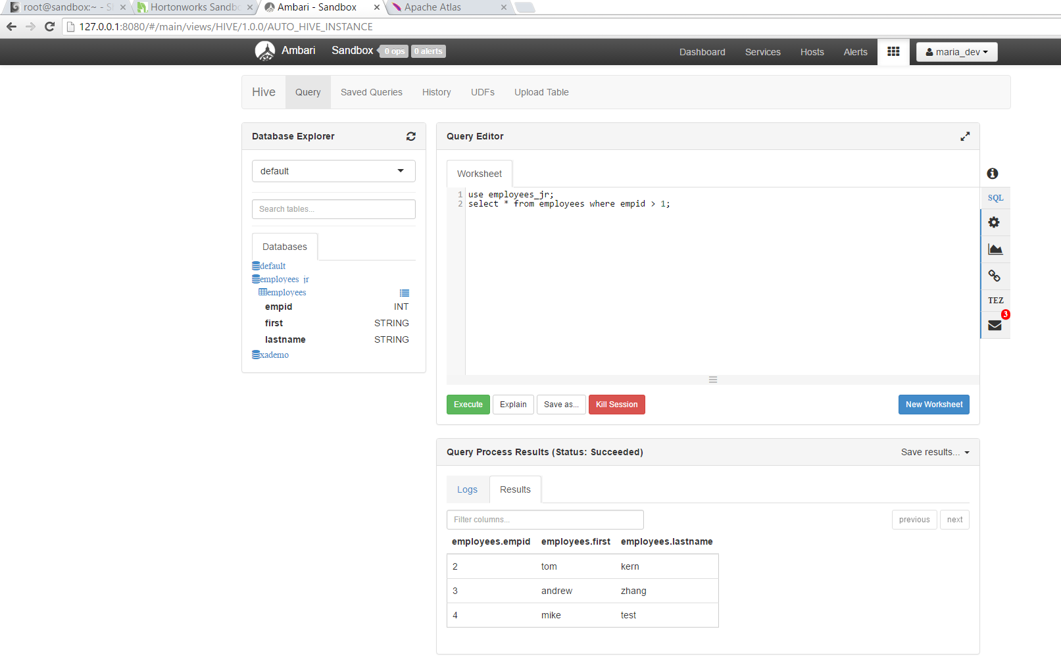
Ambari – HIVE

Slide 42
What is PIG?

Slide 43
YARN – The Data Operating System
http://hortonworks.com/hadoop/yarn/

Slide 44
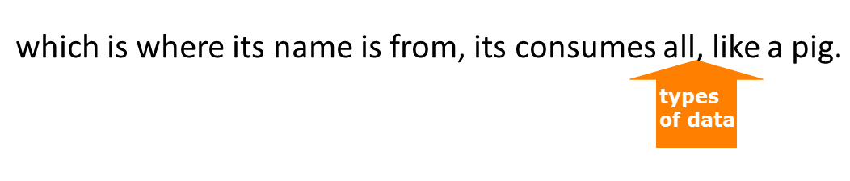
Pig
Initially developed at Yahoo!
Purpose: Spend less time writing complex programs, spend more time actually analyzing data.
Pig is meant to handle any kind of data
The framework will take care of various details for you.

Slide 45
Pig
“Apache Pig is a platform for analyzing large data sets.”
https://pig.apache.org/about.html#status
Consists of 2 parts
PigLatin Language
Runtime Environment

Slide 46
Pig
PigLatin Language
“Pig's language, Pig Latin, is a simple query algebra that lets you express data transformations such as merging data sets, filtering them, and applying functions to records or groups of records” (https://pig.apache.org/about.html#status)
The first step in a Pig program is to LOAD the data you want to manipulate from HDFS.
Then you run the data through a set of transformations (which, under the covers, are translated into a set of mapper and reducer tasks).
Finally, you DUMP the data to the screen or you STORE the results in a file somewhere.
https://www-01.ibm.com/software/data/infosphere/hadoop/pig/

Slide 47
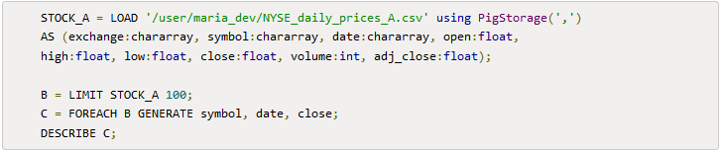
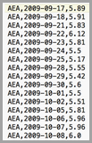
Pig
PigLatin Language
Sample Code:
Output:

Slide 48
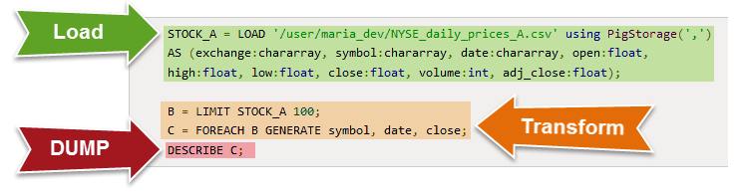
Pig
PigLatin Language
Sample Code Explained:
Remember: Load, Transform, Dump/Store

Slide 49
Pig
Runtime Environment
A runtime environment is essentially everything needed to execute a program. This includes libraries, resources, structures, settings, etc.
E.g. To run a java program you need to install the JRE, or to watch flash you need to install flash.
Pig Additionally supports
Java
Jython
Python
JavaScript
Ruby
Groovy

Slide 50
Pig
Together what does it mean?
(Language + Runtime) = Write simple scripts to do powerful data things. Pig will take care of details for you in the background.
Reiterating… Purpose: Spend less time writing complex programs, spend more time actually analyzing data.

Slide 51
Demo: Virtual Environment
Virtual Environment through VMWare
Accessing Ambari
VPN Connectivity

Slide 52
Lab Time
Questions?

